Slide 1
Very Simple Description
REST leverages the capabilities of Hypertext Transfer Protocol (HTTP) and Uniform Resource Identifiers (URIs) to retrieve or modify the state of a resource.

Slide 2
Resources
“The key abstraction of information in REST is a resource...” - Roy Fielding’s dissertation.
Resources form the nucleus of any REST API design. Resource identifiers (URI), Resource representations, API operations (using various HTTP methods), etc. are all built around the concept of Resources. It is very important to select the right resources and model the resources at the right granularity while designing the REST API so that the API consumers get the desired functionality, the APIs behave correctly and are maintainable.
A resource can be a singleton or a collection. For example, “customers” is a collection resource and “customer” is a singleton resource.
https://www.thoughtworks.com/insights/blog/rest-api-design-resource-modeling

Slide 3
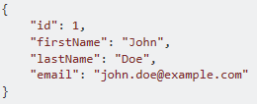
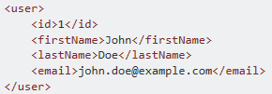
Resource Representation
A resource can be represented in multiple formats, such as JSON, XML, YAML, etc.
In JSON, the representation would be:
In XML, the representation would be the following:
https://www.thoughtworks.com/insights/blog/rest-api-design-resource-modeling

Slide 4
OpenAPI 2.0
A Swagger 2.0 file is made of 15 standardized sections, open to extensions. Only 3 of these sections are required (denoted below with bold face). These 15 sections fall into 5 main categories:
A mandatory header section (swagger)
Meta data around the API being described (info, tags, externalDocs)
Global configuration (host, basePath, schemes)
The API description (consumes, produces, paths, definitions, parameters, responses)
Security related descriptions (securityDefinitions, security).

Slide 5
A RESTful Service’s URI in Swagger Terms
https://<server_name>:<port>/<service_name>/<resource_name>
schemes
host
basePath
path

Slide 6
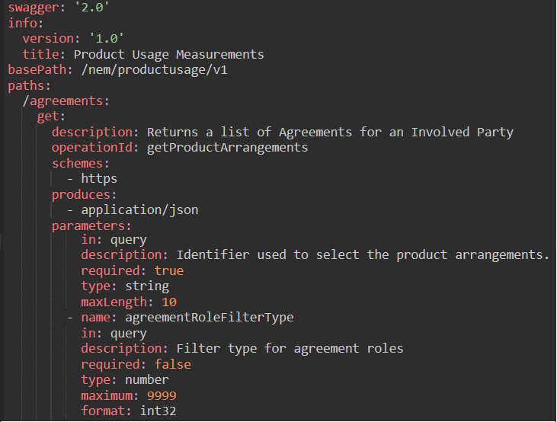
Swagger Example

Slide 7
Swagger (schemes, basePath, paths)

Slide 8
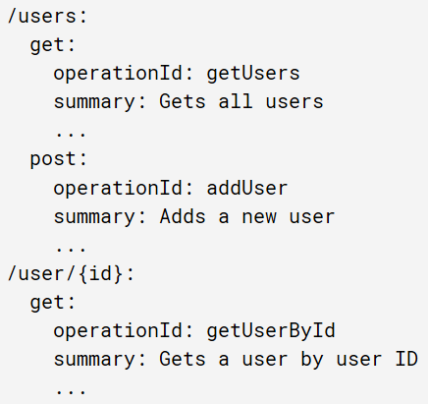
Swagger (More on paths and operations)
In OpenAPI terms, paths point to resources that the API exposes, such as /users or /user/{id}, and operations accessed by HTTP verbs , such as GET, POST or DELETE, manipulate those resources.

Slide 9
Swagger (Service Versioning via Path)

Slide 10
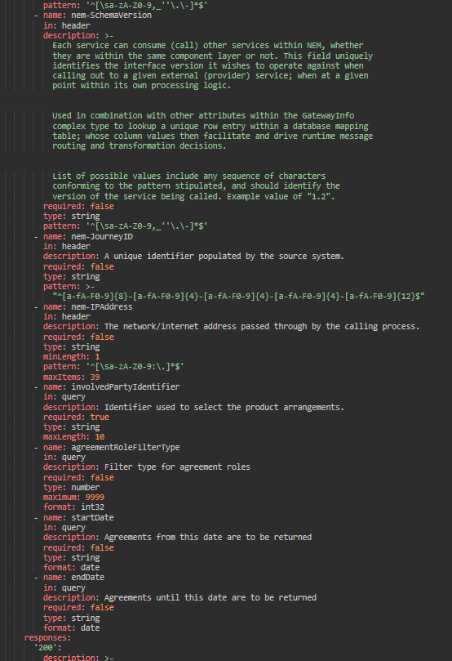
Swagger Files Grow Wildly in the Real World

Slide 11
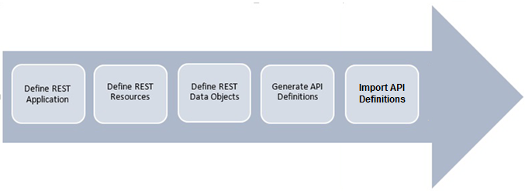
REST API using RSA and IIB
With the Swagger and REST profiles you can model in UML consumable APIs with:
Consistent resource names
Common query parameters
Simple JSON/XML data structures
RSA
IIB

Slide 12
REST Applications
The REST Application represents the set of Resources being provided by the service. They define the scope of a service and the path dependencies between Resources.
The REST Application defines the Swagger basePath and therefore the component to be versioned.
Stereotype: <<SwaggerApp>>

Slide 13
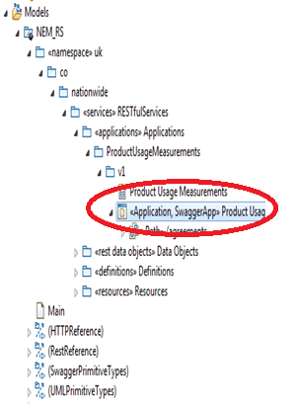
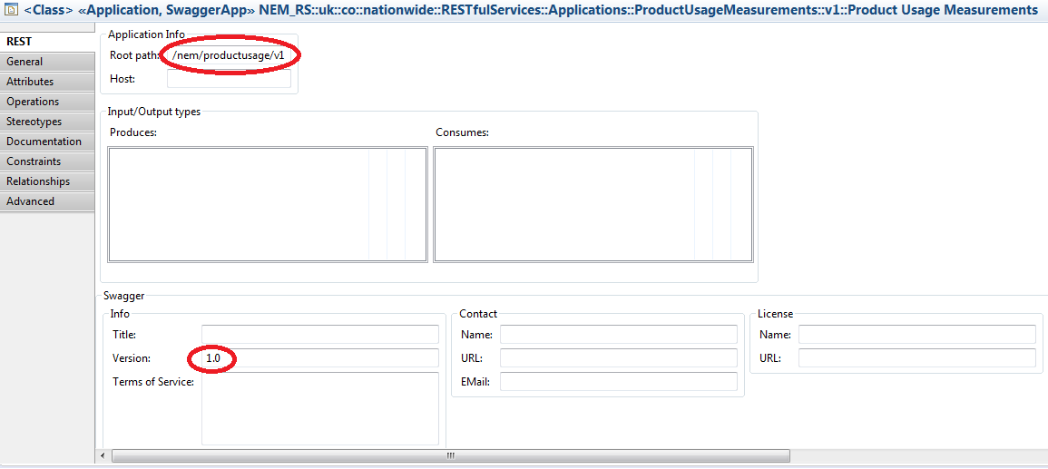
REST Applications

Slide 14
REST Resources
A resource is an addressable artefact on the web. They are objects with a defined type, associated data, methods (HTTP verbs) that operate on them, and relationships to other Resources within Application. They can be:
Collection Resources
Member Resource
Member Virtual Resources (defined by the enclosing collection)
Stereotype: <<Resource>>
Resources can have links to other resources which are UML dependency relationship applied to control how URIs can be constructed.
Stereotype: <<Path>>

Slide 15
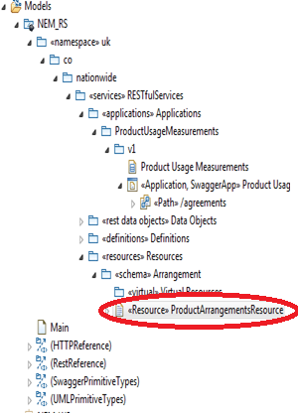
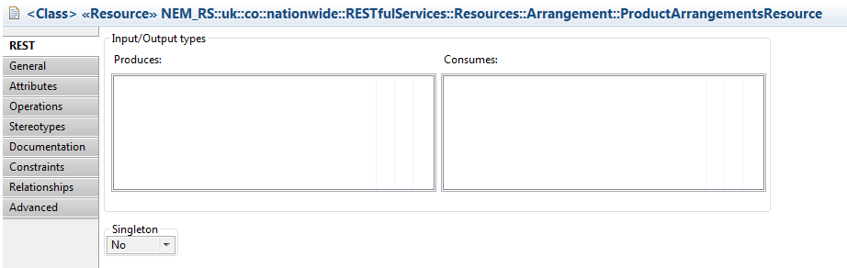
REST Resources

Slide 16
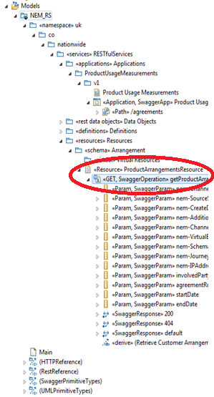
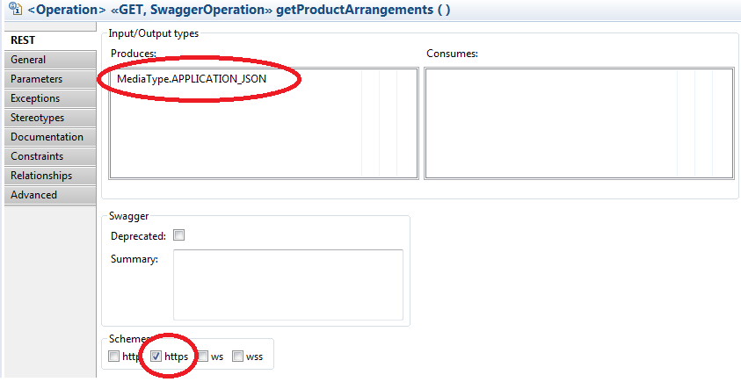
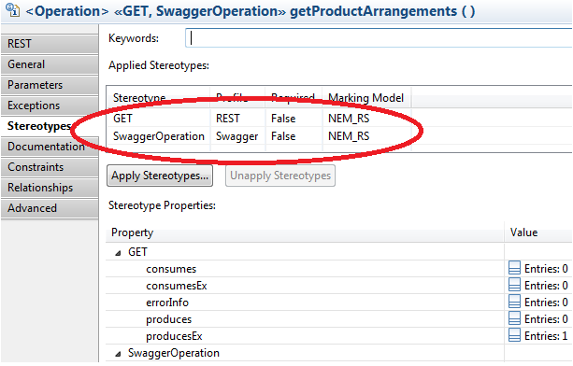
REST Operations

Slide 17
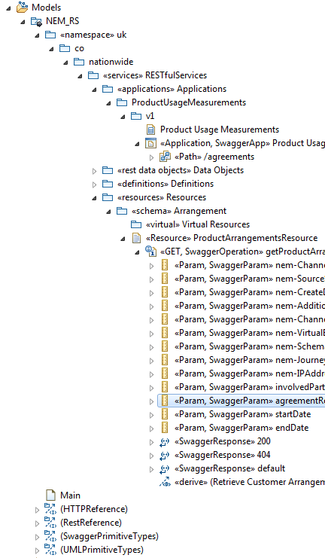
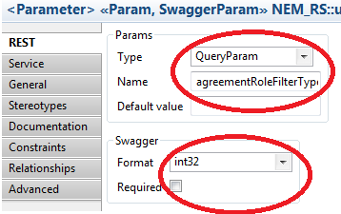
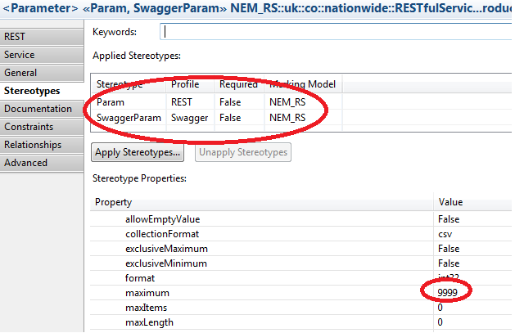
REST Parameters

Slide 18
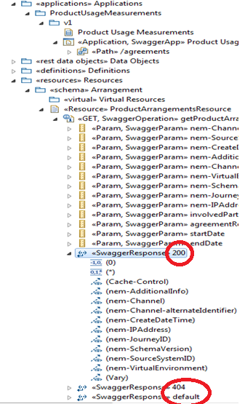
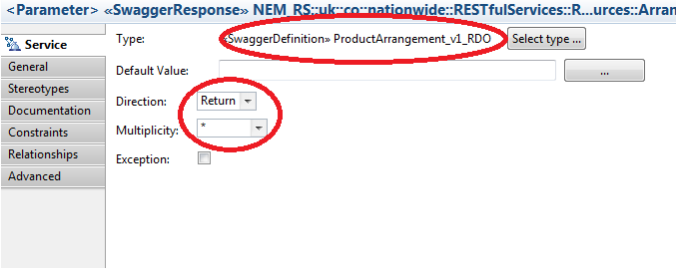
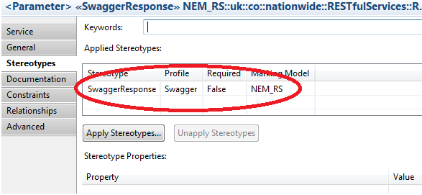
REST Responses

Slide 19
REST data objects (Transfer Objects)
The data associated with Resources are modelled as classes (and can be called REST Data Objects or RDOs).
RDOs allow you to explicitly define, at modelling time, the structure of the JSON/XML messages that will be used in the APIs.
Stereotypes: <<Swagger Definition>> <<Swagger Property>>
For example, the ProductArrangement_RDO contains an Attribute arrangementIdentifier of type ArrangementIdentifier_RDO which in turn contains additional typical attributes such as accountNumberSCAN and ukDomesticSortCode.

Slide 20
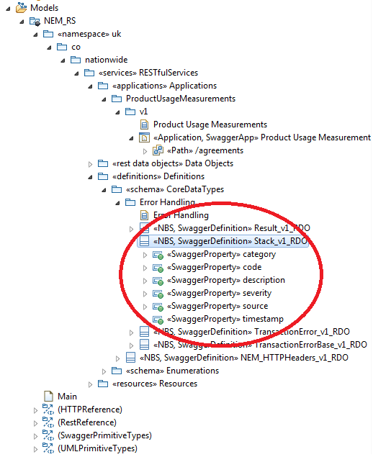
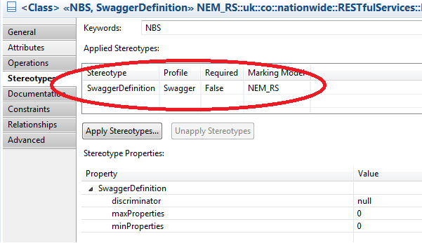
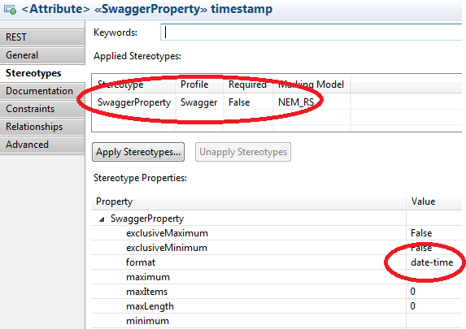
REST data objects (Transfer Objects)

Slide 21
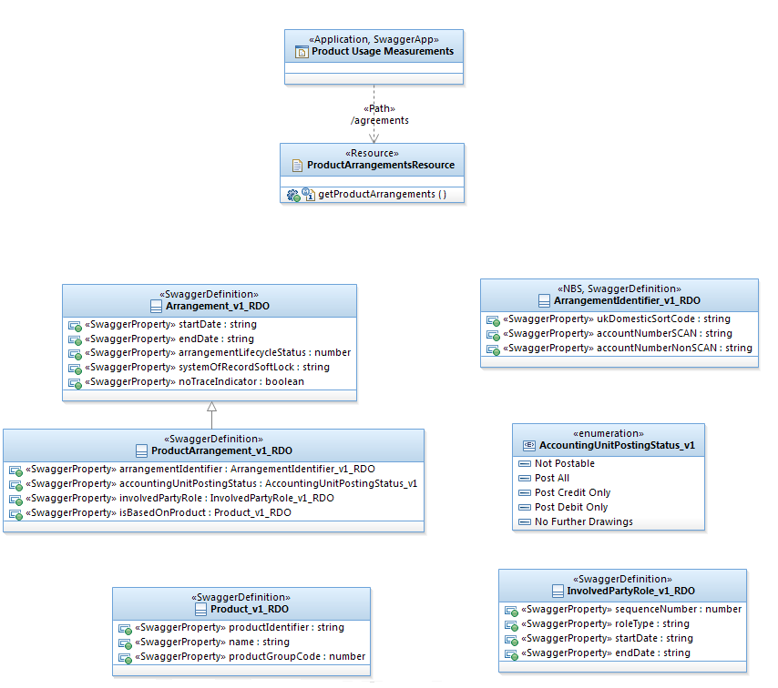
Application + Resources + RDOs = REST service
Application
Resource
Data Model

Slide 22

Try it for Yourself – A 64-bit Windows 7 VM is All You Need
Installing RSA 9.6.1 with RTC 4.0.7 client:
\\Dvmsdnw01\nemdc\Software\Installers - RSA\RSA Tooling Installation Guides\Installing RSAD 961 With RTC 407.docx
Configuring RSA for browsing IFW 8.9.1 (plenty of examples)
\\Dvmsdnw01\nemdc\Software\Installers - RSA\RSA Tooling Installation Guides\Installation Guide - IFW 8.9.1 for RSA 9.6.1.docx

Slide 23
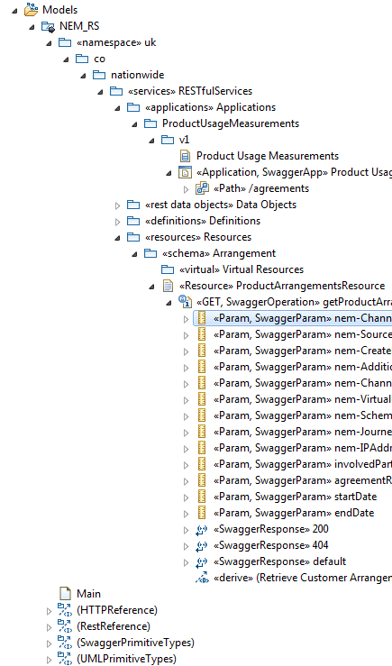
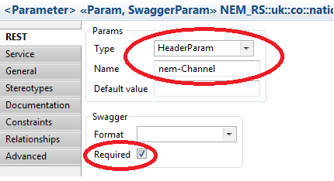
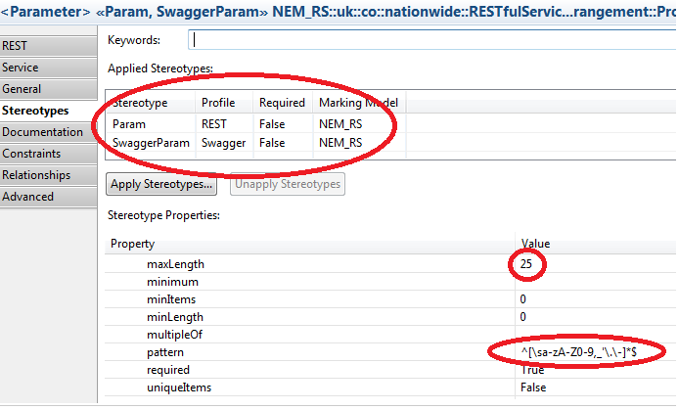
HTTP Request Header

Slide 24
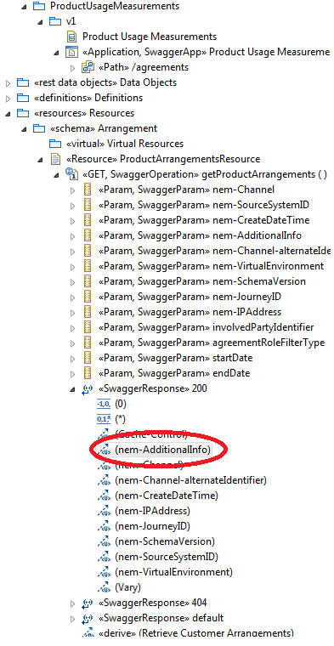
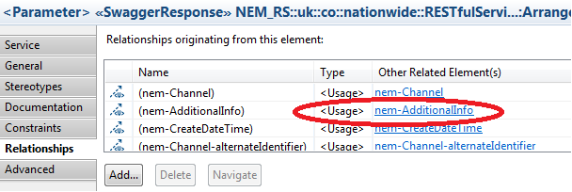
HTTP Response Header

Slide 25
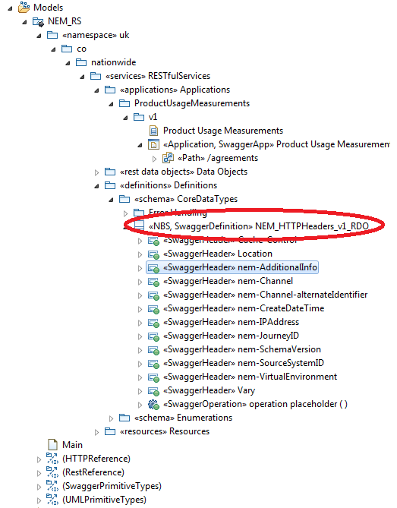
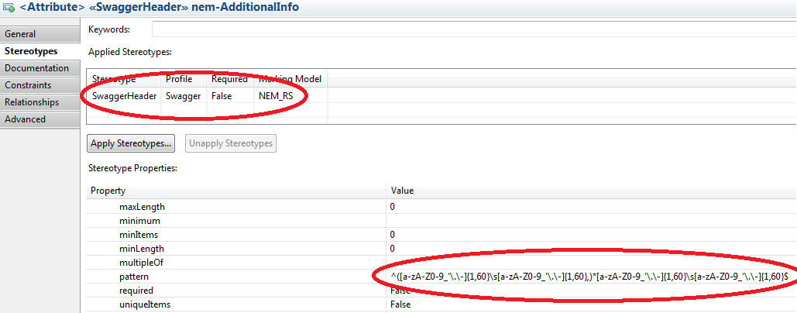
HTTP Response Header (Cont’d)

Slide 26
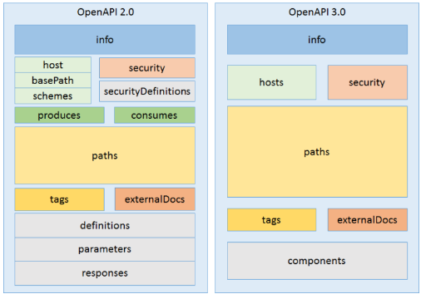
OpenAPI 2.0 vs 3.0

Slide 27
OpenAPI 3.0.0 (What’s new)
Structure rearranged for easier and extended reusability.
Extended JSON Schema support to include `oneOf`, `anyOf` and `not`.
Allowed the use of schema in parameters.
Added support for Cookie parameters and eliminated dataForm.
Body parameters were extracted to their own entity.
Added support for content type negotiation.
Introduced a new format to allow static linking between responses and future requests.
Simplified and enhanced security definitions of APIs.
Added a callback mechanism to describe WebHooks.
https://www.openapis.org/blog/2017/01/24/a-new-year-a-new-specification

